Slide 1
Enhancing Blur
Jack Topper

Slide 2
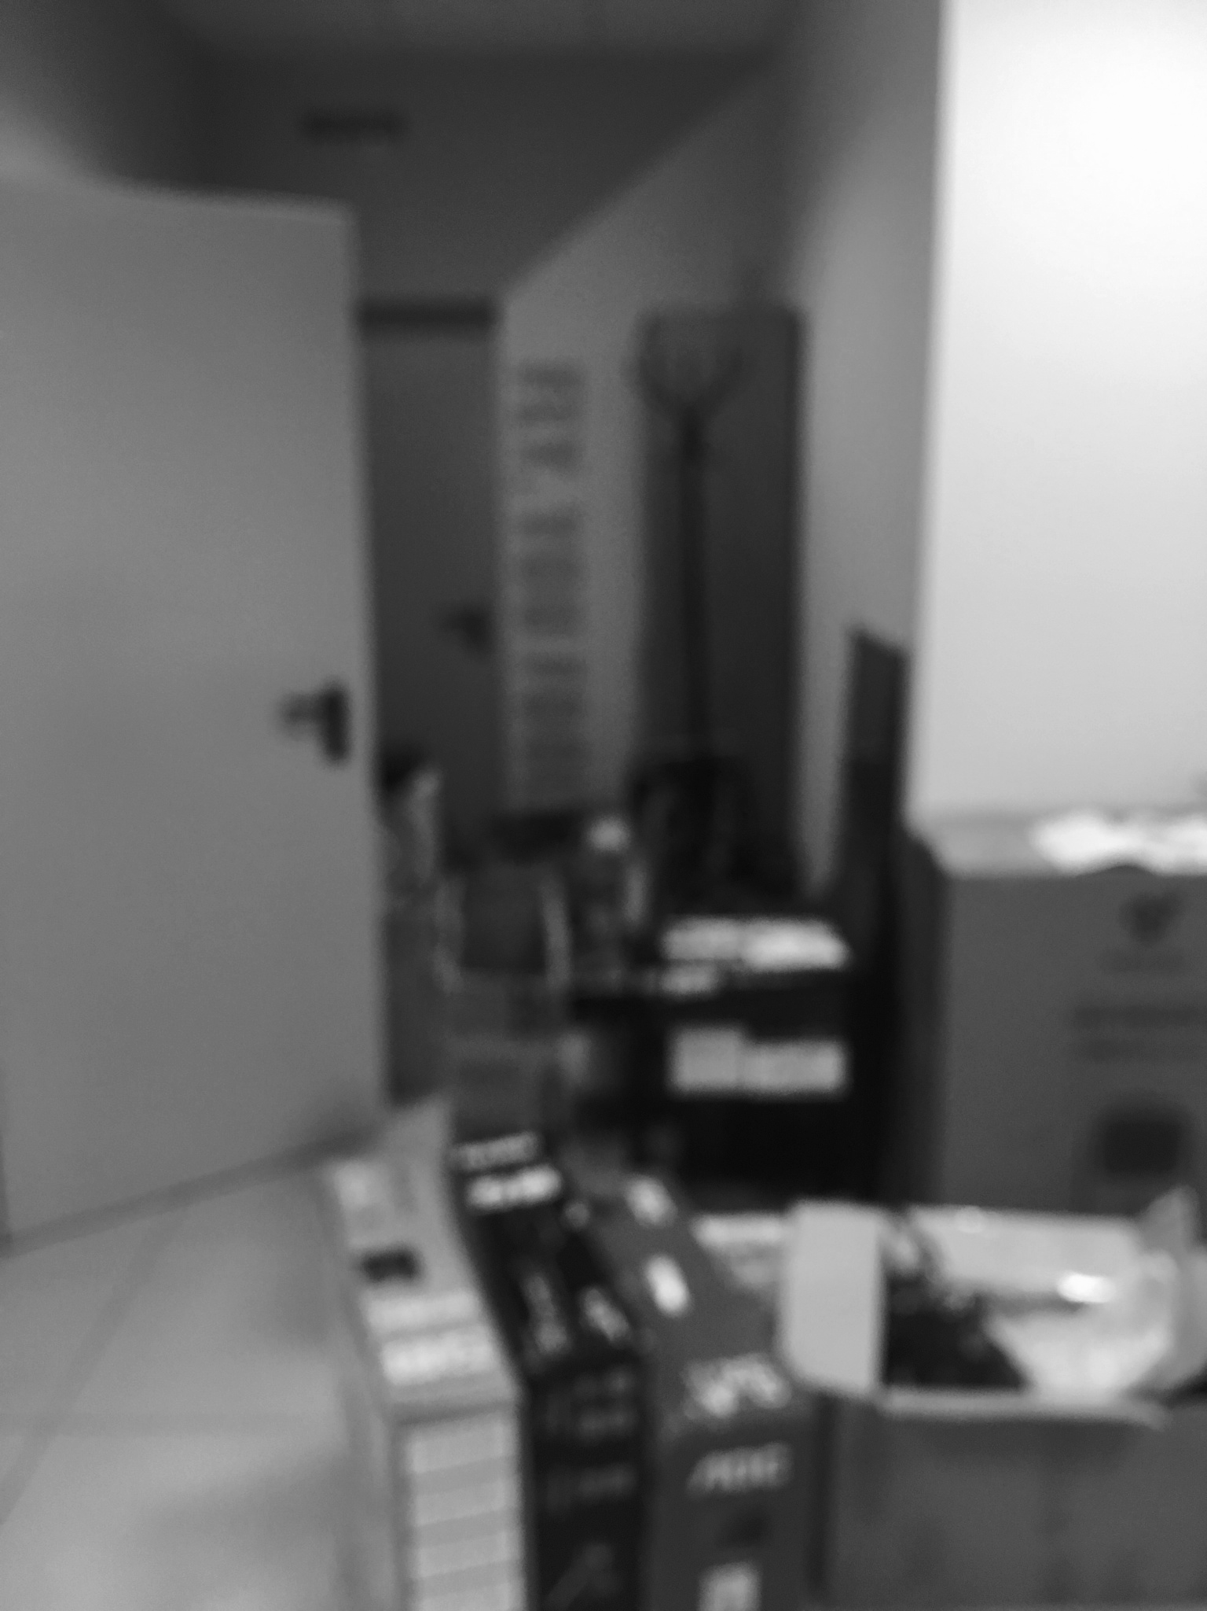
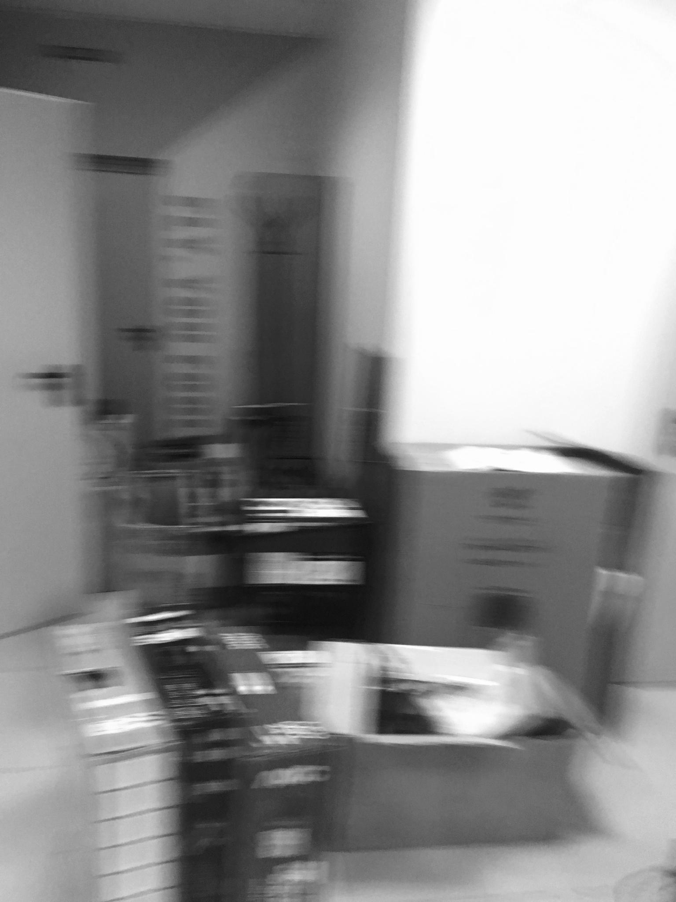
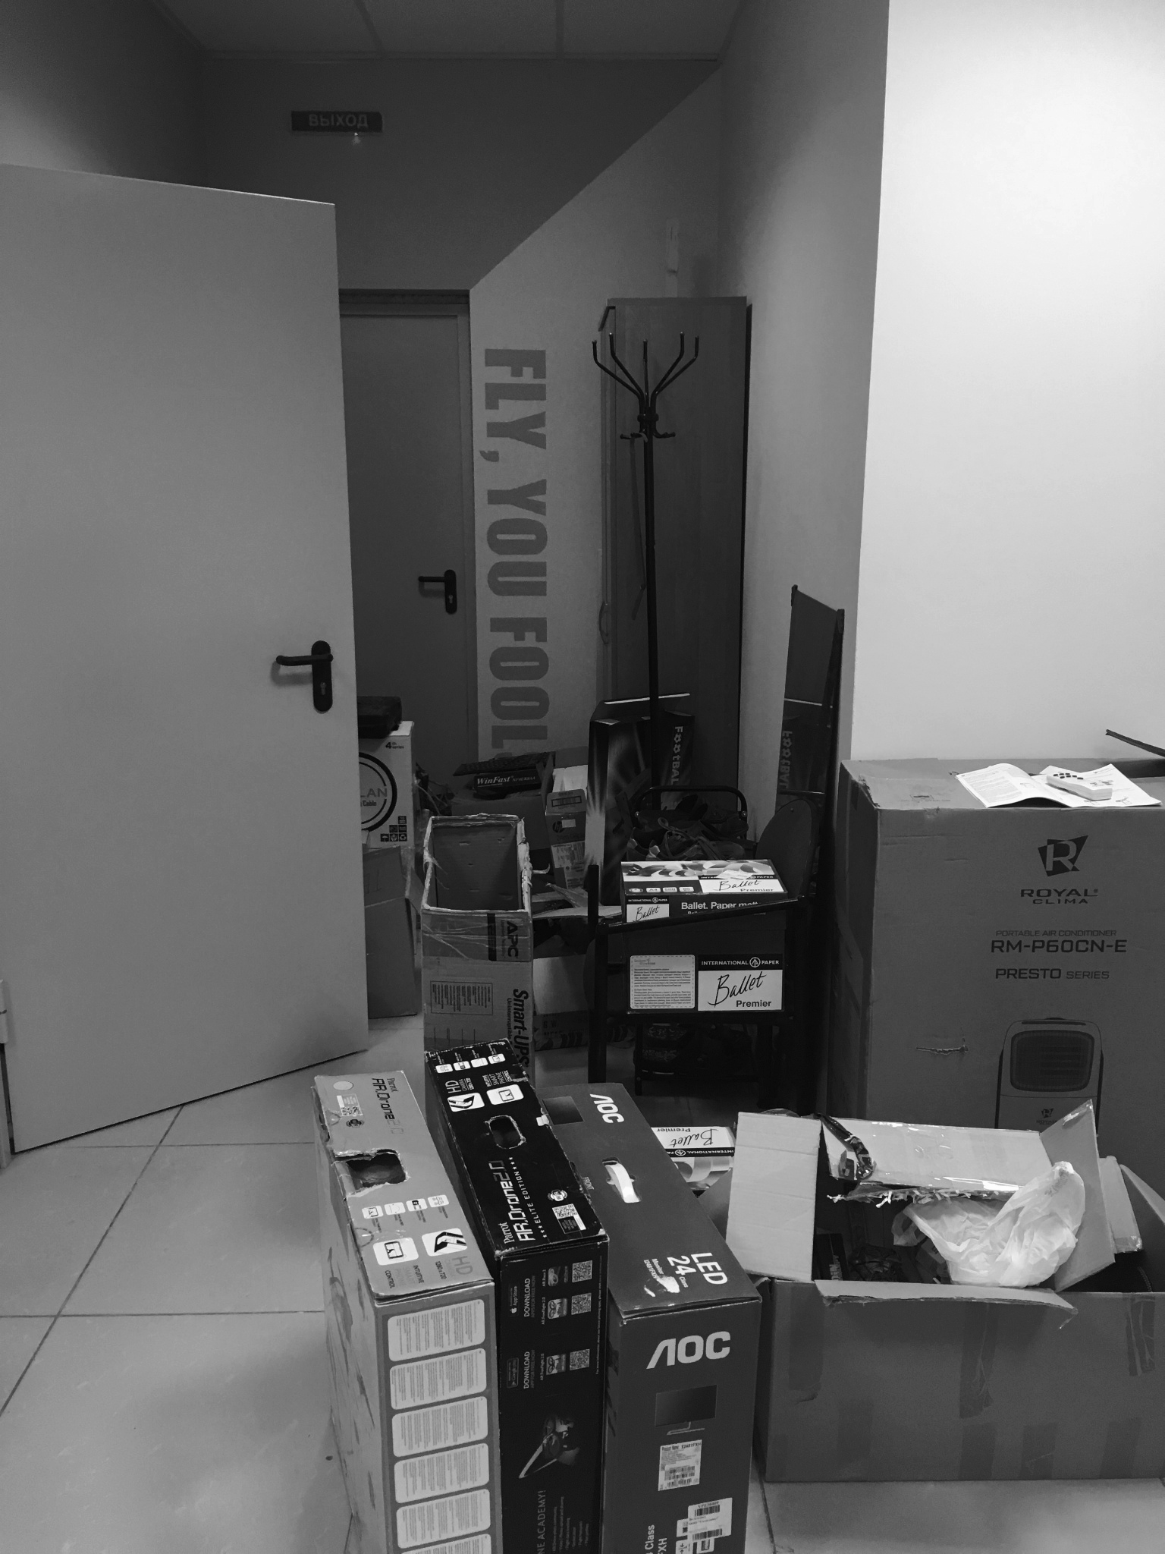
Defocused Blur
Motion Blur
Sharp

Slide 3

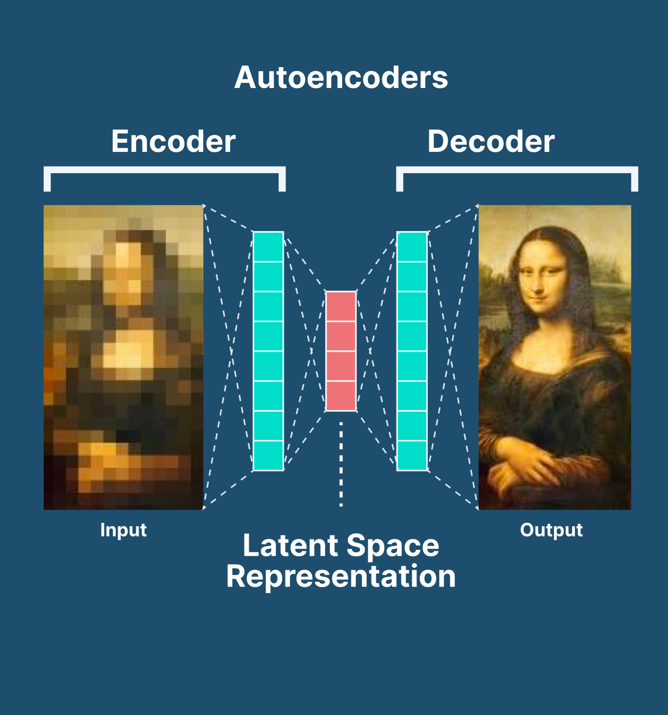

Slide 4
Deep Fully Connected
_________________________________________________________________
Layer (type) Output Shape Param #
================================================================
input_30 (InputLayer) [(None, 2795520)] 0
_________________________________________________________________
dense (Dense) (None, 1024) 2862613504
_________________________________________________________________
dense_1 (Dense) (None, 256) 262400
_________________________________________________________________
dense_2 (Dense) (None, 64) 16448
_________________________________________________________________
dense_3 (Dense) (None, 32) 2080
_________________________________________________________________
dense_4 (Dense) (None, 64) 2112
_________________________________________________________________
dense_5 (Dense) (None, 256) 16640
_________________________________________________________________
dense_7 (Dense) (None, 2795520) 718448640
=================================================================
Total params: 3,581,361,824
Trainable params: 3,581,361,824
Non-trainable params: 0
_________________________________________________________________

Slide 5
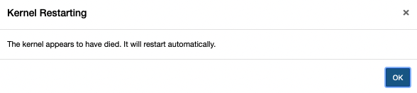
I got 99 Problems but they’re all my neural network
Error: Out of memory when allocating tensor

Slide 6
→ One layer removal →
_________________________________________________________________
Layer (type) Output Shape Param #
==============================================================
input_30 (InputLayer) [(None, 2795520)] 0
_________________________________________________________________
dense (Dense) (None, 1024) 2862613504
_________________________________________________________________
dense_1 (Dense) (None, 256) 262400
_________________________________________________________________
dense_2 (Dense) (None, 64) 16448
_________________________________________________________________
dense_3 (Dense) (None, 32) 2080
_________________________________________________________________
dense_4 (Dense) (None, 64) 2112
_________________________________________________________________
dense_5 (Dense) (None, 256) 16640
_________________________________________________________________
dense_7 (Dense) (None, 2795520) 718448640
==============================================================
Total params: 3,581,361,824
Trainable params: 3,581,361,824
Non-trainable params: 0
_________________________________________________________________
___________________________________________________________
Layer (type) Output Shape Param #
=========================================================
input_4 (InputLayer) [(None, 2795520)] 0
____________________________________________________________
dense_7 (Dense) (None, 256) 715653376
____________________________________________________________
dense_8 (Dense) (None, 64) 16448
____________________________________________________________
dense_9 (Dense) (None, 32) 2080
____________________________________________________________
dense_10 (Dense) (None, 64) 2112
____________________________________________________________
dense_11 (Dense) (None, 256) 16640
____________________________________________________________
dense_12 (Dense) (None, 2795520) 718448640
==========================================================
Total params: 1,434,139,296
Trainable params: 1,434,139,296
Non-trainable params: 0
_____________________________________________________________

Slide 7
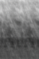
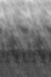
Epoch 1/50
60/60 [==============================] - 239s 4s/step - loss: 0.7223
Epoch 2/50
60/60 [==============================] - 239s 4s/step - loss: 0.6921
Epoch 3/50
60/60 [==============================] - 239s 4s/step - loss: 0.6929
Epoch 4/50
60/60 [==============================] - 240s 4s/step - loss: 0.6898
Epoch 5/50
60/60 [==============================] - 240s 4s/step - loss: 0.6843
Epoch 6/50
60/60 [==============================] - 239s 4s/step - loss: 0.6837
Epoch 7/50
60/60 [==============================] - 240s 4s/step - loss: 0.6829
Epoch 8/50
60/60 [==============================] - 239s 4s/step - loss: 0.6829
Epoch 9/50
60/60 [==============================] - 238s 4s/step - loss: 0.6831
Epoch 10/50
60/60 [==============================] - 239s 4s/step - loss: 0.6832
Epoch 11/50
60/60 [==============================] - 238s 4s/step - loss: 0.6831
Epoch 12/50
60/60 [==============================] - 239s 4s/step - loss: 0.6827
Epoch 13/50
60/60 [==============================] - 239s 4s/step - loss: 0.6828
Epoch 14/50
60/60 [==============================] - 238s 4s/step - loss: 0.6829
Epoch 15/50
10/60 [====>.........................] - ETA: 3:19 - loss: 0.6846
Back to the drawing board...

Slide 8
Deep Convolutional Autoencoder
Model:
_________________________________________________________________
Layer (type) Output Shape Param #
=================================================================
input_29 (InputLayer) [(None, 2048, 1365, 1)] 0
_________________________________________________________________
conv2d_166 (Conv2D) (None, 2048, 1365, 256) 2560
_________________________________________________________________
max_pooling2d_25 (MaxPooling2D) (None, 1024, 682, 256) 0
_________________________________________________________________
conv2d_168 (Conv2D) (None, 1024, 682, 64) 147520
_________________________________________________________________
conv2d_169 (Conv2D) (None, 1024, 682, 64) 36928
_________________________________________________________________
up_sampling2d_24 (UpSampling2D) (None, 2048, 1364, 64) 0
_________________________________________________________________
zero_padding2d_10 (ZeroPaddiing2D (None, 2048, 1365, 64) 0
_________________________________________________________________
conv2d_171 (Conv2D) (None, 2048, 1365, 256) 147712
_________________________________________________________________
conv2d_172 (Conv2D) (None, 2048, 1365, 1) 2305
=================================================================
Total params: 337,025
Trainable params: 337,025
Non-trainable params: 0

Slide 9
OOM when allocating tensor
Resizing of our images (Resolution)
Reduce the amount of kernels
Reduce the amount of layers

Slide 10
_________________________________________________________________
Layer (type) Output Shape Param #
==============================================================
input_5 (InputLayer) [(None, 750, 500, 1)] 0
_________________________________________________________________
conv2d_28 (Conv2D) (None, 750, 500, 256) 25856
_________________________________________________________________
max_pooling2d_4 (MaxPooling2D) (None, 375, 250, 256) 0
_________________________________________________________________
conv2d_30 (Conv2D) (None, 375, 250, 64) 147520
_________________________________________________________________
conv2d_31 (Conv2D) (None, 375, 250, 64) 36928
_________________________________________________________________
up_sampling2d_4 (UpSampling2D) (None, 750, 500, 64) 0
_________________________________________________________________
conv2d_33 (Conv2D) (None, 750, 500, 256) 1638656
_________________________________________________________________
conv2d_34 (Conv2D) (None, 750, 500, 1) 2305
==============================================================
Total params: 1,851,265
Trainable params: 1,851,265
Non-trainable params: 0
_________________________________________________________________

Slide 11
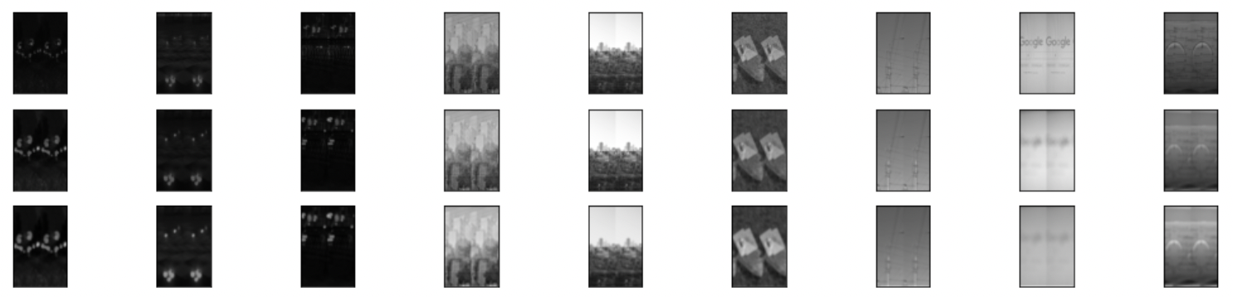
Sharp
Reconstructed
Blur

Slide 12


GAN Approach
Discriminator
Generator

Slide 13
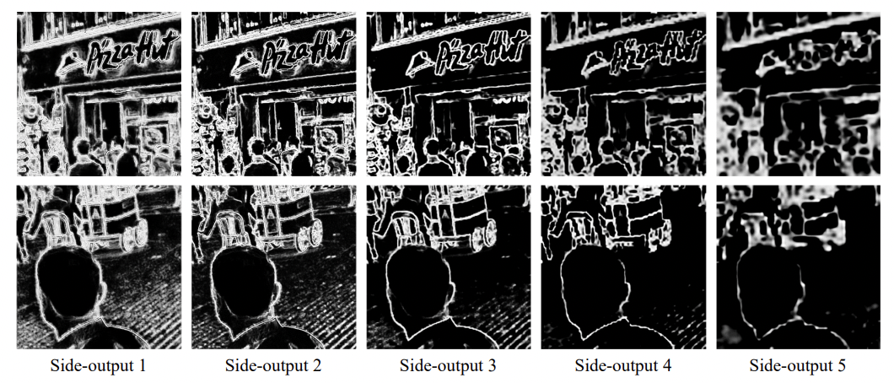
Edge-Aware Deep Image Deblurring

Slide 14
Kaggle (data set)
https://www.kaggle.com/kwentar/blur-dataset
EdgeNet
https://arxiv.org/pdf/1907.02282.pdf
Sharpening blur using convolutional neural networks
https://www.bibliomed.org/?mno=105516

